Slide 1
CSE 2201 Design and Analysis of Algorithms – I Lecture 3 Articulation Points, Bridges & Bi-connected Components
Hasnain Heickal
Assistant Professor
Department of CSE, University of Dhaka

Slide 2
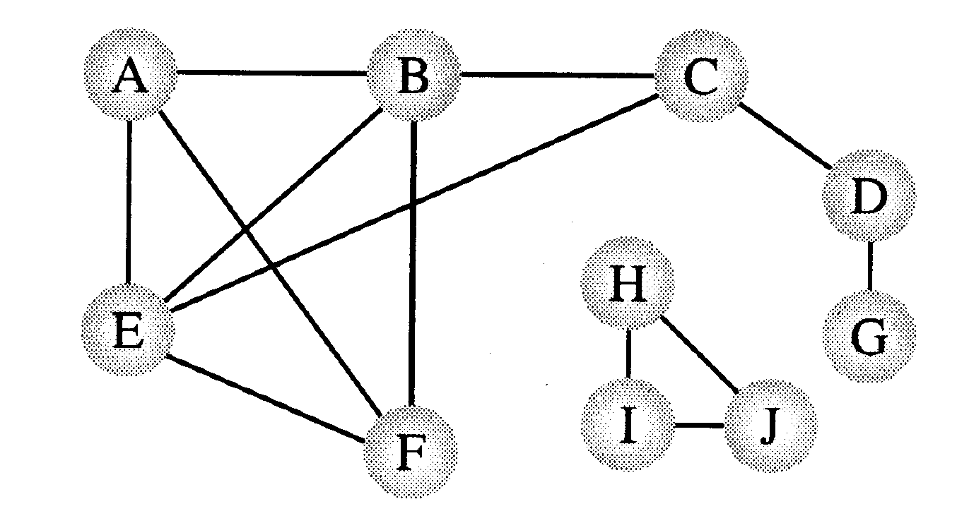
Connectivity/Biconnectivity for Undirected Graph
A node and all the nodes reachable from it compose a connected component. A graph is called connected if it has only one connected component.
Since the function visit() of DFS visits every node that is reachable and has not already been visited, the DFS can easily be modified to print out the connected components of a graph.
Two connected components

Slide 3
Connectivity/Biconnectivity
In actual uses of graphs, such as networks, we need to establish not only that every node is connected to every other node, but also there are at least two independent paths between any two nodes. A maximum set of nodes for which there are two different paths is called biconnected components.
{H,I,J} and {A,B,C,E,F} are biconnected.

Slide 4
Connectivity/Biconnectivity
Another way to define this concept is that there are no single points of failure, no nodes that when deleted along with any adjoining arcs, would split the graph into two or more separate connected components. Such a node is called an articulation point.
If a graph contains no articulation points, then it is biconnected. If a graph does contain articulation points, then it is useful to split the graph into the pieces where each piece is a maximal biconnected subgraph called a biconnected component.

Slide 5

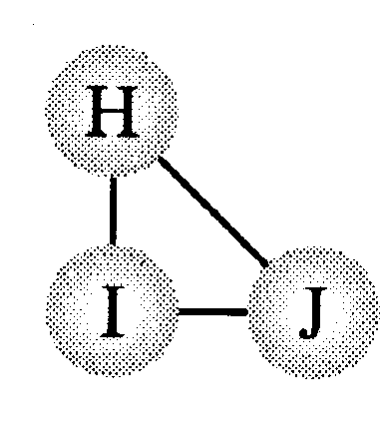
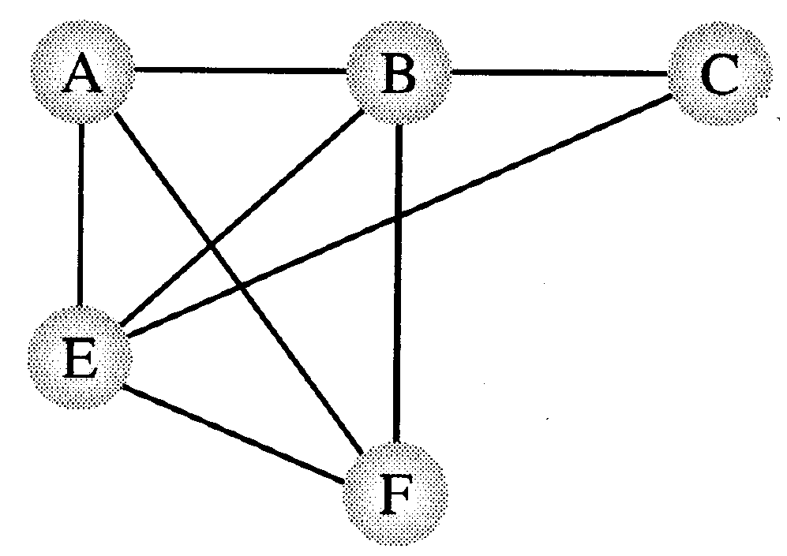
Connectivity/Biconnectivity
Articulation points
Three biconnected components

Slide 6
Finding Articulation Points
Problem:
Given any graph G = (V, E), find all the articulation points.
Possible strategy:
For all vertices v in V:
Remove v and its incident edges
Test connectivity using a DFS.
Execution time: Θ(n(n+m)).
Can we do better?

Slide 7
Finding Articulation Points
A DFS tree can be used to discover articulation points in Θ(n + m) time.

Slide 8
A
A
E
E
B
B
D
D
I
I
C
F
F
C
H
H
G
G
A
B
C
D
Can you characterize D ?
F
E
G
H
I

Slide 9
Depth First Search number
A
B
C
F
G =(V, E)
D
E
1
A
2
A B C D E F
1 2 3 9 6 4
B
9
3
D
C
F
4
E
6
Any relation between Discovery time and articulation point ?

Slide 10
A
1
B
2
Assume that (a,b) ⇔ a → b
Tree edge : (a,b) a < b
Back edge : (a,b) a > b
9
3
D
C
F
4
E
6
w’
v
If there is a back edge from x
to a proper ancestor of v,
then v is reachable from x.
w
x

Slide 11
Finding Articulation Points
A DFS tree can be used to discover articulation points in Θ(n + m) time.
We start with a program that computes a DFS tree labeling the vertices with their discovery times.
We also compute a function called low(v) that can be used to characterize each vertex as an articulation or non-articulation point.
The root of the DFS tree will be treated as a special case:
The root has a d[] value of 1.

Slide 12
Definition of low(v)
Definition. The value of low(v) is the discovery time of the vertex closest to the root and reachable from v by following zero or more tree edges downward, and then at most one back edge.
We can efficiently compute Low by performing a postorder traversal of the depth-first spanning tree.
low[v] = min{
d[v],
lowest d[w] among all back edges (v,w)
lowest low[w] among all tree edges (v,w)
}
In English: low(v) < d[v] indicates if there is another way to reach v which is not via its parent

Slide 13
Low(v)
Observe that if there is a back edge from somewhere below v to above v in the tree, then low(v) < d[v]
Otherwise low(v) = d[v]
Root
v
w
back edges

Slide 14
Finding Articulation Points
Let v be a non-root vertex of the DFS tree T.
Then v is an articulation point of G if and only if
there is a child w of v with low(w) >= d[v].

Slide 15
Articulation Points: Pseudocode
Data: color[V], time, prev[V],d[V], f[V], low[V]
DFS(G) // where prog starts
{
for each vertex u ∈ V
{
color[u] = WHITE;
prev[u]=NIL;
low[u]=inf;
f[u]=inf; d[u]=inf;
}
time = 0;
for each vertex u ∈ V
if (color[u] == WHITE)
DFS_Visit(u);
}

Slide 16
Articulation Points: Pseudocode
DFS_Visit(v)
{ color[v]=GREY;time=time+1;d[v] = time;
low[v]= d[v];
for each w ∈ Adj[v]{
if(color[w] == WHITE){
prev[w]=u;
DFS_Visit(w);
if low[w] >= d[v]
record that vertex v is an articulation
if (low[w] < low[v]) low[v] := low[w];
}
else if w is not the parent of v then
//--- (v,w) is a BACK edge
` if (d[w] < low[v]) low[v] := d[w];
}
color[v] = BLACK; time = time+1; f[v] = time;
}

Slide 17
Special Case
When “v” is a root of the DFS tree, you have to check it manually.

Slide 18
Finding Articulation Points
The root of the DFS tree is an articulation point if and only if it has two or more children.
Suppose the root has two or more children.
Recall that back edges never link vertices between two different subtrees.
So, the subtrees are only linked through the root vertex and its removal will cause two or more connected components (i.e. the root is an articulation point).
Suppose the root is an articulation point.
This means that its removal would produce two or more connected components each previously connected to this root vertex.
So, the root has two or more children.

Slide 19
Source
Mark Allen Weiss – Data Structure and Algorithm Analysis in C
Articulation Point
Exercise:
CLRS – Exercise 22-2

Slide 20
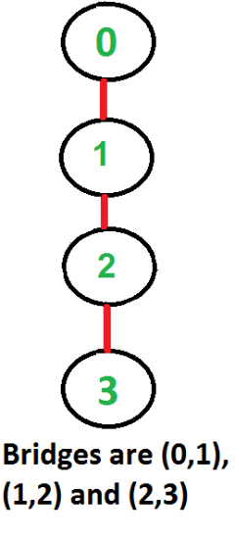
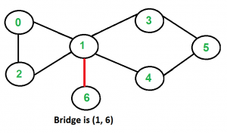
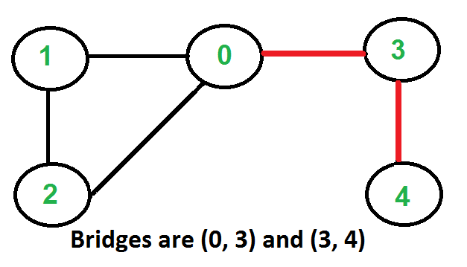
Bridge
An edge in an undirected connected graph is a bridge iff removing it disconnects the graph. For a disconnected undirected graph, definition is similar, a bridge is an edge removing which increases number of disconnected components.

Slide 21
How to Find Bridges
Does finding articulation points helps?
What can be the special cases?

Slide 22
Bridge: Pseudocode
DFS_Visit(v)
{ color[v]=GREY; time=time+1; d[v] = time;
low[v]= d[v];
for each w ∈ Adj[v]{
if(color[w] == WHITE){
prev[w]=u;
DFS_Visit(w);
if low[w] > d[v]
record that vertex (v, w) is a bridge (WHY??)
if (low[w] < low[v]) low[v] := low[w];
}
else if w is not the parent of v then
//--- (v,w) is a BACK edge
` if (d[w] < low[v]) low[v] := d[w];
}
color[v] = BLACK; time = time+1; f[v] = time;
}

Slide 23
Biconnected Components (BCC)
Biconnected Graph: An undirected graph is called Biconnected if there are two vertex-disjoint paths between any two vertices. In a Biconnected Graph, there is a simple cycle through any two vertices.
Biconnected Componets: A biconnected component is a maximal biconnected subgraph
In graph, following are the bcc(s):
4–2 3–4 3–1 2–3 1–2
8–9
8–5 7–8 5–7
6–0 5–6 1–5 0–1
10–11

Slide 24
Algorithm
https://www.hackerearth.com/practice/algorithms/graphs/biconnected-components/tutorial/

